Slide 1
Driving Revenue Growth Through Customer Analytics
SuperFoodsMax (From 2019 to 2022)
FINAL PROJECT – RMIT Online: Business Analytics
Joshua Aloba
15 December 2025

Slide 2
Business question: How can superfoodsmax increase its sales revenue by 5% over the next two years?
This analysis will focus on:
  Increase in the average spending of existing loyal customers.
  Improvement in the conversion of first-time customers in to existing loyal customers.

Slide 3
Why does this matter for decision makers?
The revenue growth has stagnated despite the ongoing customer acquisitions.
Loyal customers will typically:
  Spends more in each transactions.
  Purchases more frequently.
A high number of first-time customers do not return, limiting its long-term value.

Slide 4
DATASET OVERVIEW
Dataset: SuperFoodsMax sales data (2019-2022)
Data type: transactional customer sales data
Key fields used:
  Customer ID
  Transaction date
  Revenue / Order value
  Basket or transaction identifier

Slide 5
Data Cleaning & preparation
In preparation for the dataset analysis:
  Coversion date fields to datetime format.
  Removed records with missing or invalid customer identifiers.
  Standardised column names for consistency.
  Created derived fields:
    Year and month
    Transaction value
    Customer purchase frequency

Slide 6
Customer definitions of term
A New Customer is a customer with only one purchase during the analysis period.
And, a Loyal Customer is a customer with two or more purchase occasions.

Slide 7
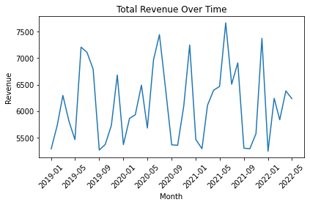
Revenue Trend over time
Key insight:
Revenue shows relatively flat growth over time, indicating that existing strategies may not be sufficient to reach the targeted 5% increase.

Slide 8
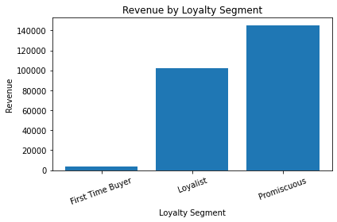
Revenue contribution: loyal versus new customers
Key insight:
While loyal customers represent a smaller proportion of total customers, they contribute a disproportionately larger share of total revenue.

Slide 9
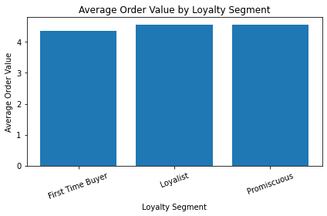
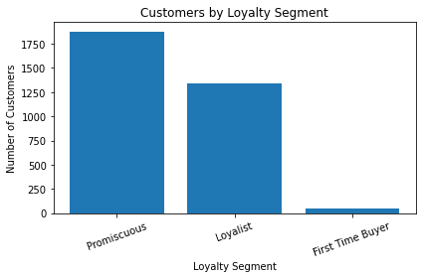
SPEND & CONVERSION INSIGHT
Key insight:
Loyal customers have a higher average spending per transaction
A significant proportion of customers make only on purchase and do not convert into repeat buyers.

Slide 10
OPPORTUNITY TO ACHIEVE
+5% REVENUE GROWTH
Based on Analysis:
A modest increase in loyal customer average spend, or
A small improvement in first time customer conversion could collectively deliver the targeted 5% revenue growth over two years.

Slide 11
RECOMMENDATIONS
Introduce targeted loyalty incentives to encourage repeat purchases.
Improve the post-purchase communication and offers for first-time customers.
Track key KPIs such as repeat purchase rate, average order value, and loyal customer revenue share.

Slide 12
REFERENCES
SuperFoodsMax. (2019–2022) Sales dataset 2019–2022 [data set], provided as part of the RMIT Online Business Analytics with Python and SQL course.
Python Software Foundation. (2025) Python programming language [software], version 3.x, available at: https://www.python.org/ (Accessed: December 2025).
The pandas development team. (2025) pandas: Python data analysis library [software], version 2.x, available at: https://pandas.pydata.org/ (Accessed: December 2025).
Matplotlib Development Team. (2025) Matplotlib: Visualization with Python [software], version 3.x, available at: https://matplotlib.org/ (Accessed: December 2025).
RMIT University Library. (2025) RMIT Harvard referencing guide, Easy Cite, available at: https://www.lib.rmit.edu.au/easy-cite/?styleguide=styleguide-1 (Accessed: December 2025).
PS: Sorry, I’ve been trying to catch-up since I’ve been sick on/off for the past weeks. TY!

